Slide 1

PROJECT TITLE
Enter the project title here
RAMDEOBABA
UNIVERSITY
Members:
  Vaishnavi Singh – 01
  Vidhita Bais – 05
  Apeksha Sharma – 10
  Gunjal Mandawkar – 39
Guided By:
Dr. M.B Chandak
Director Academics & Professor, Department of CSE
Department: Computer Science & Engineering
Programme: IDEA Lab
Academic Year: 2026–27
Idea lab/Honor/
Minor/Major
COURSE CODE

Slide 2
2
PROBLEM STATEMENT
Problem Statement
  Insurance companies process a large number of claims, making manual fraud investigation slow, costly and difficult to scale.
Who is affected?
Insurance companies
Claims adjusters/investigators
Current challenges
  Manual investigation
  Rule-based systems
  Delayed genuine claims
Problem We Address
  How can AI autonomously investigate and triage insurance claims while providing evidence-based, explainable recommendations to human adjusters?
?
U
Genuine policyholders
Fraud-risk and compliance teams
!
i
Standalone ML models
Low explainability
02 September 2026
Slide 2 of 10

Slide 3
EXISTING SOLUTION / LITERATURE REVIEW
Existing Solutions:
Rule-Based Fraud Detection: Static rules; difficult to detect new fraud patterns.
Machine Learning-Based Detection: Provides fraud scores but limited reasoning.
AI-Based Insurance Pipelines: Fixed workflows; limited autonomous investigation.
LLM / Agentic AI: Limited insurance-specific fraud detection and evidence verification.
1
EXISTING SOLUTIONS
LIMITATIONS
2
Work | Approach | Limitation
Devender et al., 2026 | Agentic insurance processing | Lacks ML scoring/retrieval/HITL
Khalil et al., 2024 | ML fraud detection | No reasoning/retrieval
Dhieb et al., 2020 | AI fraud-risk pipeline | Fixed pipeline
Urunkar et al., 2022 | Random Forest | Single classification output
Yao et al., 2022 | ReAct agents | General-purpose domain
3

Slide 4
4
PROPOSED SOLUTION
Project idea
  AI-powered insurance claims system combining ML fraud detection + Agentic AI investigation.
Proposed approach
  Claim → Fraud Score → Investigation → Evidence → Reasoning → Recommendation → Human Decision
  Key innovation
  ML + Agentic AI Explains why a claim is suspicious
  Autonomous investigation & evidence retrieval Suggests the next action
Expected outcome
Approve
  Flag for Investigation
  Request More Information
1
2
3
INNOVATION
4

Slide 5
5
OBJECTIVES
1 Fraud Prediction
Develop an ML/DL model to estimate the probability of insurance claim fraud.
2 Autonomous Investigation
Design an LLM-based agentic orchestrator that can plan and execute multi-step claim-triage tasks using tools.
3 Evidence-Based Decision Support
Implement similar-claim retrieval, policy/history verification and explainable reasoning to generate structured recommendations.
4 Human-in-the-Loop System
Develop a lightweight dashboard that allows adjusters to review, approve, modify, override, and provide feedback on AI recommendations.
Expected Target
Build an end-to-end prototype that converts a raw insurance claim into an explainable, evidence-supported triage
recommendation.
04
03
02
01
K

Slide 6
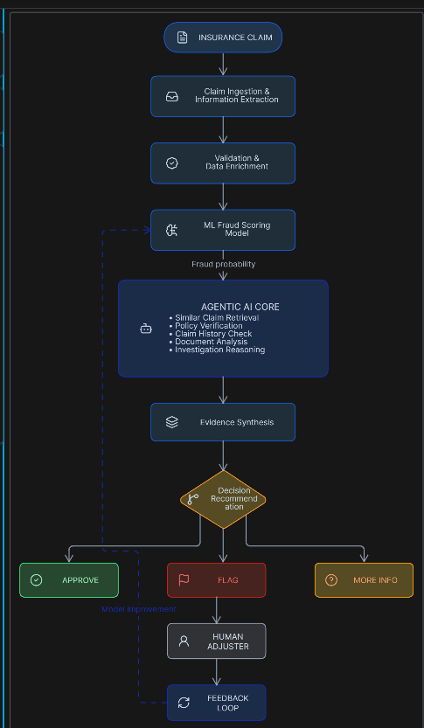
6
SYSTEM ARCHITECTURE / METHODOLOGY
Methodology:
Ingest claim information.
Validate and enrich claim data.
Generate ML fraud probability.
Agent determines what evidence needs to be investigated.
Retrieve similar claims and historical information.
Perform policy and consistency checks.
Synthesize evidence.
Generate explainable recommendation.
Human adjuster reviews/overrides.
Store feedback for future model improvement.

Slide 7
7
IMPLEMENTATION
Dataset:
  Car Insurance Claim Prediction
  X Claims | 43 Features
Agentic AI:
  Fraud Scoring Agent
  Similar Claim Retrieval
  Policy Verification
  Investigation & Reasoning
PROTOTYPE / SYSTEM IMAGE
ML Model:
  Data Preprocessing
  Feature Engineering
  Fraud Classification
  Explainable AI (SHAP)
Prototype Development
  Claim Input → Fraud Score → Investigation → Recommendation
  Human Adjuster Review & Feedback
Current Status: Foundation & architecture completed; ML and agentic pipeline under development.

Slide 8
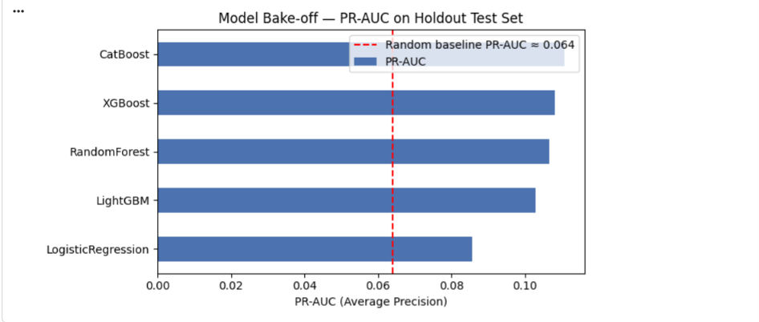
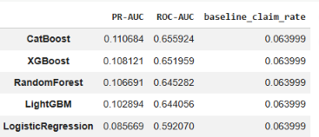
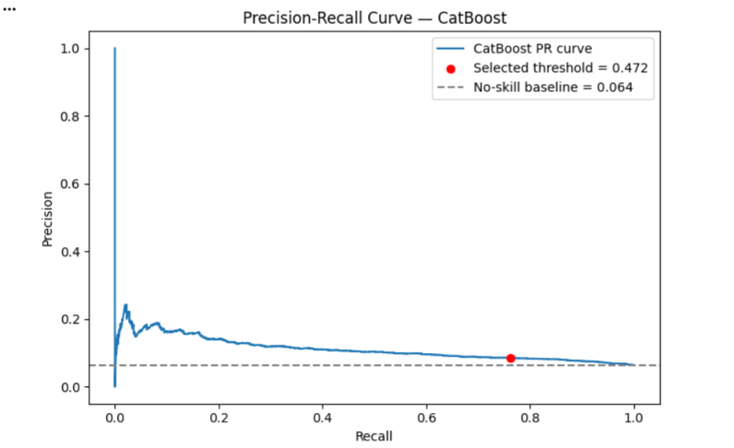
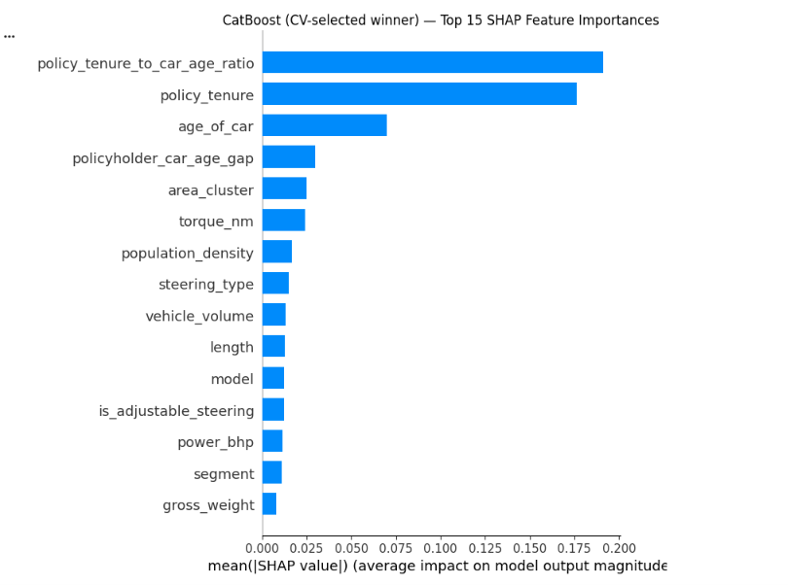
8
RESULTS / PROTOTYPE
SCREENSHOTS
✓

Slide 9
9
INNOVATION, IMPACT, DELIVERABLES & FUTURE SCOPE
Innovation:
Traditional System: Claim → ML Model → Fraud Score
Our System: Claim → ML Score → Agentic Investigation → Evidence → Explanation → Recommendation → Human Review
IMPACT:
  Reduces manual workload Faster & consistent claim processing
  Prioritizes high-risk claims Helps adjusters make informed decisions
DELIVERABLES
  EDA & cleaned dataset Explainability + retrieval module
  Fraud detection ML model Agentic investigation pipeline
FUTURE SCOPE
  OCR & document analysis Policy database integration
  Accident image analysis Advanced claimant history
★
↗
U

Slide 10
CONCLUSION & REFERENCES
CONCLUSION:
The proposed system combines ML-based fraud-risk prediction with Agentic AI to transform insurance claims processing from a simple fraud-score system into an evidence-based investigation and triage workflow.
REFERENCES
Devender et al., “Agentic AI: Insurance Claim Processing System,” 2026.
Khalil et al., “Machine Learning Based Method for Insurance Fraud Detection…”, IEEE Access, 2024.
Dhieb et al., “A Secure AI-Driven Architecture for Automated Insurance Systems…”, IEEE Access, 2020.
Urunkar et al., “Fraud Detection and Analysis for Insurance Claim using Machine Learning,” IEEE SPICES, 2022.
Yao et al., “ReAct: Synergizing Reasoning and Acting in Language Models,” 2022.
Chen & Guestrin, “XGBoost: A Scalable Tree Boosting System,” KDD, 2016.
Lundberg & Lee, “A Unified Approach to Interpreting Model Predictions,” NeurIPS, 2017.

